Slide 1
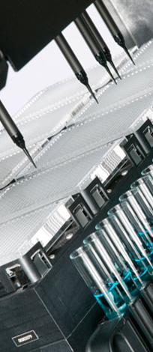
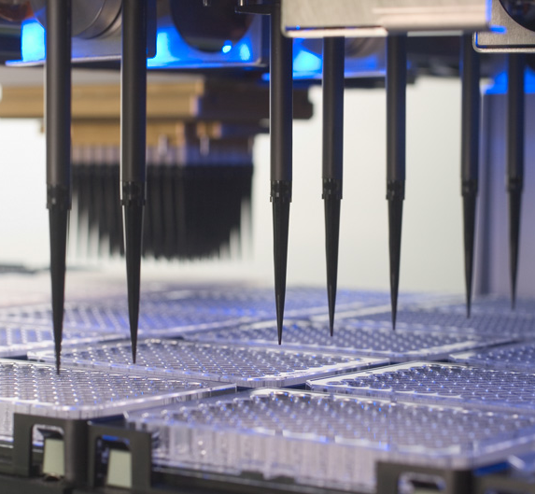
HAMILTON MICROLAB® STAR
Liquid Handling &
Liquid Class Determination

Slide 2
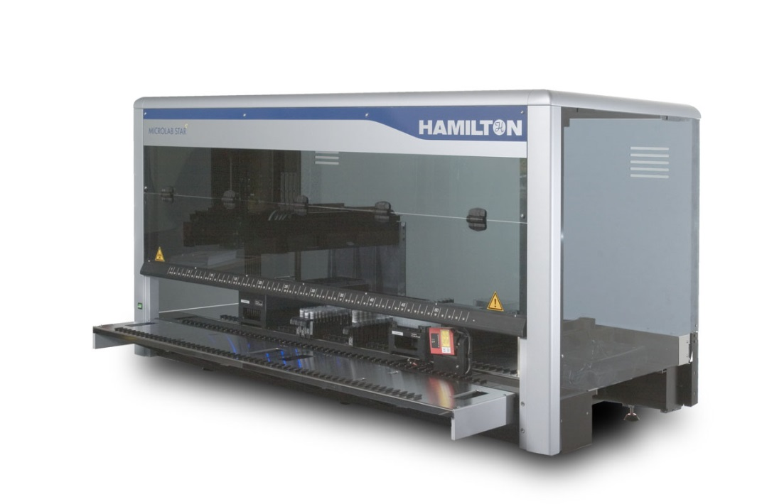
Liquid Class Dependencies
Liquid properties
Tip or needle type
Aspiration and Dispense modes
Method parameters
Pipetting tool

Slide 3
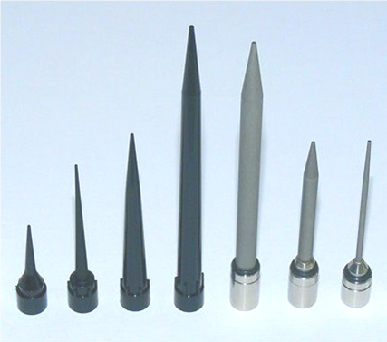
Tip Types
Size
  Affects flow
Material
  Different surface properties affect wetting and adhesion
Filtered or non-filtered
  Affects flow
Geometry
  Affects flow, wetting, and adhesion

Slide 4
Aspirate and Dispense Modes
Aspiration modes
  Aspiration (simple transfer)
  Consecutive (subsequent aspiration)
  Aspirate all (MAD off; get what is available)
Dispense modes
  Surface empty tip or part volume
  Jet empty tip or part volume
Jet Dispense
Surface Dispense

Slide 5
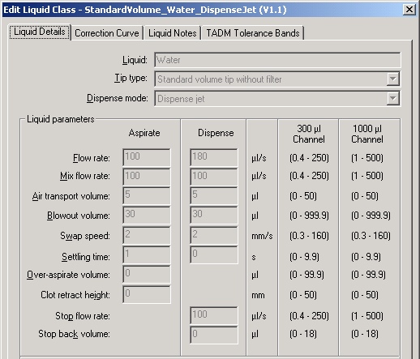

Aspirate and Dispense Modes
Jet Dispense
Surface Dispense

Slide 6
Method settings
Single- or multiple-use of tips
Aliquotting or single dispenses
Washing of tips/needles
Pre-wetting/pre-mixing
Follow on or off
Aspiration and dispense heights
LLD

Slide 7
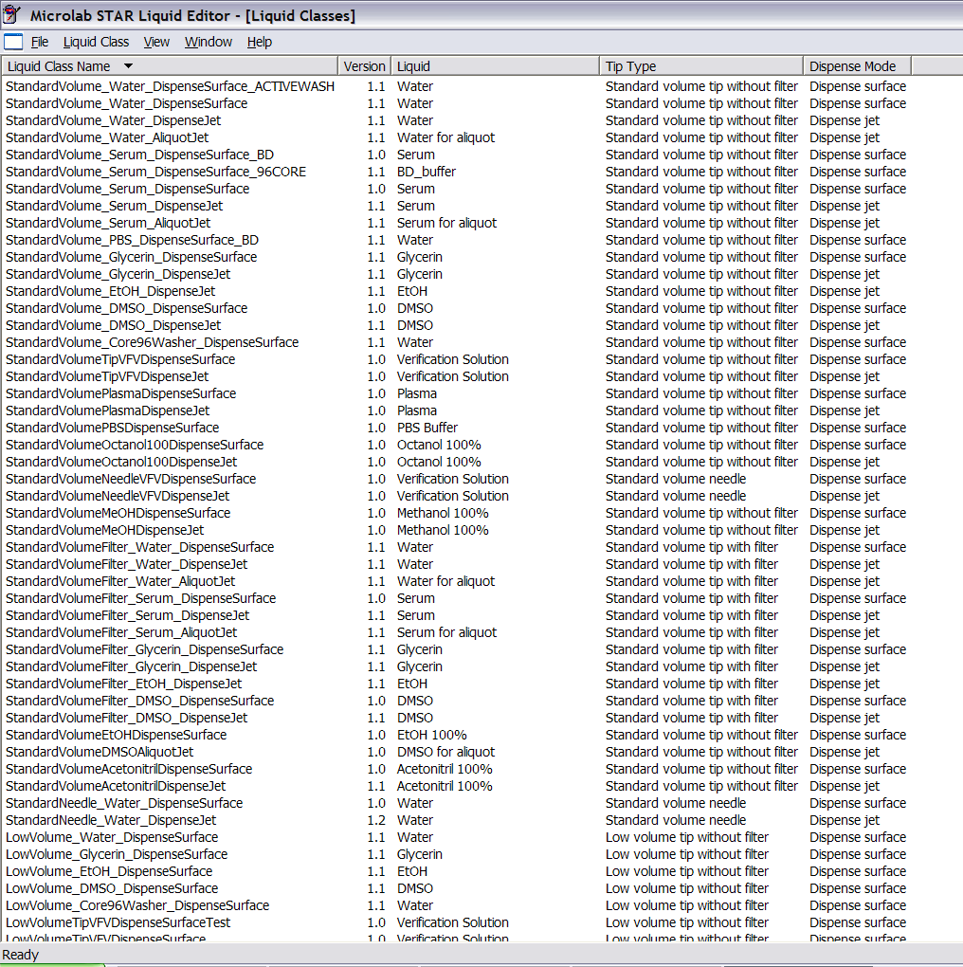
Start with existing liquid class
Water for
  Aqueous solutions
Ethanol for
  Volatile solvents
DMSO for
  Organic solvents
Glycerin for
  Viscous liquids
Serum for
  Blood products

Slide 8
Run your method with the fluid
If you see droplet formation
  Edit method to
    Avoid tips waiting to dispense
    Try pre-mixing to condition the tips
Evaluate precision (CV), and if unacceptable
  Edit method to
    Use pre- and post-dispense when aliquotting
    Adjust dispense heights
Try to Optimize Method Parameters First

Slide 9
After initial method optimization
Time to Start the Liquid Class Optimization Process
Save the initial liquid class under a different name
Reference the new liquid class in the method
Start writing down your changes and results
Change only 1 parameter at a time
Look carefully at the tip during the pipetting process
Work toward achieving requirements visually (i.e., no droplets)
Move toward analytically measuring results with the VFV balance or some other valid method
The method may need editing between LC changes, depending on your investigation results

Slide 10
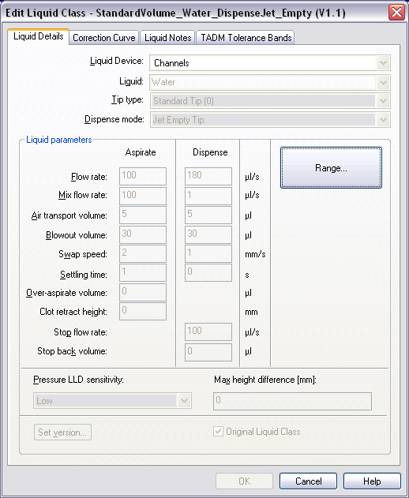
Liquid Class Parameters
Set proper Liquid, Tip Type, Dispense Mode (and Device) values
Note value ranges: 300ul for 96 head, 1000ul for channels
Change only 1 thing at a time
Change only those parameters that will be used!

Slide 11
Parameters: Flow Rate
Corresponds to plunger speed
Aspiration
  Slower for smaller tip diameters
  Faster for more volatile liquids
  Slower for more viscous liquids
Dispense
  Slower for smaller tip diameters
  Slower for surface dispense
  Faster for jet dispense
  Faster for more volatile liquids
  Slower for more viscous liquids

Slide 12
Parameters: Mix Flow Rate
Usually equal to or less than Asp/Disp flow rates
Slower for smaller tip diameters
Slower for highly volatile liquids
Slower for more viscous liquids

Slide 13
Parameters: Blowout Volume
Larger for more viscous liquids
Aspiration
  Must be equal than or greater than that set for the Dispense
  Larger than that set for Dispense when pipetting highly volatile liquids, to provide greater head space
Dispense
  May create bubbles/foam in liquid if used in surface mode, except when pipetting highly viscous liquids
  Could cause aerosols in jet mode

Slide 14
Parameters: Air Transport Volume
Aspirated at the end of the aspiration and dispense steps and automatically dispensed again as an extra volume in the first part of the dispense step
Can help prevent droplet formation
Dispense value is aspirated after the dispense
5 to 30ul is usually adequate
Larger for more volatile liquids
Smaller for small tips
Bigger is not always better (you could get leaks)
Should be less than the liquid volume inside the tip

Slide 15
Parameters: Settling Time
Δt
Time the dispensing head remains in the liquid after aspirating or dispensing, before moving out of the liquid
Shorter (0-2s) for aqueous solutions
Very short (0-1s) for highly volatile solutions
Longer (2-9.9s) for viscous solutions
Very short for steel needles
Longer for surface dispense into empty wells

Slide 16
Parameters: Swap speed
Speed in mm/s at which the dispensing head is drawn up out of the liquid
Slower (1-2mm/s) for more viscous fluids
Faster (10-100mm/s) for more volatile fluids

Slide 17
Parameters: Over-Aspirate Volume
ΔV_{o-a}
A kind of pre-wetting volume in ml. After aspirating the required volume, the over-aspirate volume is aspirated, and then the over-aspirate volume is dispensed again immediately.
Use especially for small volumes (<10ul)
Smaller than aspirated volume
Larger for viscous or volatile liquids

Slide 18
Parameters: Clot Retract Height
This parameter enables the recognition of blood clots. It determines how high the dispensing head is allowed to move up out of the liquid after aspiration with an active cLLD signal. It is measured in mm from the height of the liquid surface upwards. An error message is generated if this distance is exceeded.
Doesn’t affect accuracy and precision (unless your submerge depth or following puts the tip too far into the fluid)
Only used to help detect clots after aspiration, and only when cLLD is turned on

Slide 19
Parameters: Stop Flow Rate
Dispense flow rate in μl/s, at which the dispensing step terminates abruptly
Equal to or less than Dispense flow rate
Slower for surface dispense (smaller than the Dispense flow rate)
Faster for jet dispense (generally equal to Dispense flow rate)
V(disp)
t

Slide 20
Parameters: Stop Back Volume
Volume in ul which is aspirated again immediately after the dispense. This volume is aspirated as quickly as possible.
Helps prevent droplets after dispense in jet mode part volume mode
Larger for more viscous liquids

Slide 21
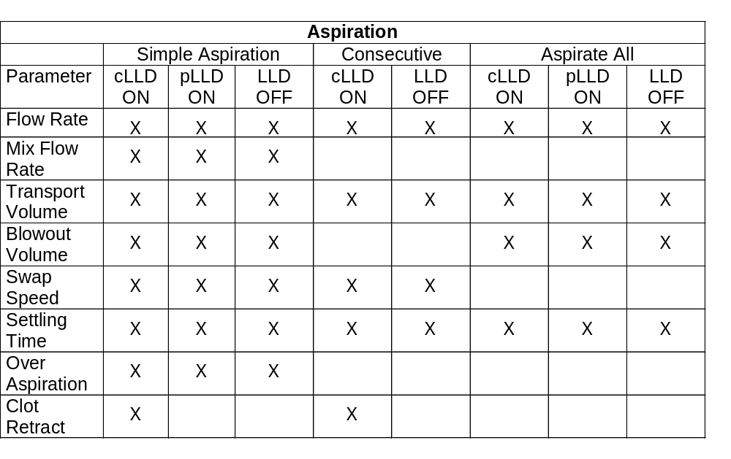
Active parameters
Change Only Active Parameters!
Aspiration mode?
cLLD or pLLD on or off?

Slide 22
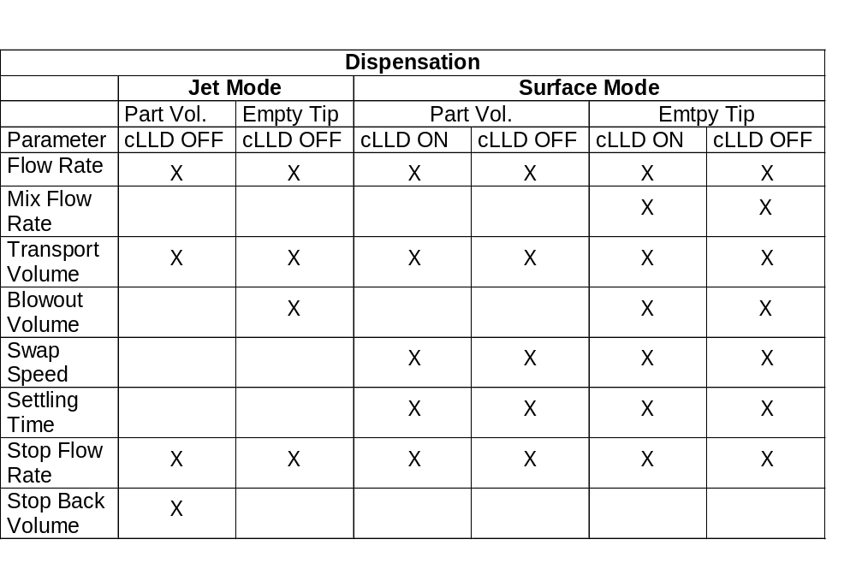
Active parameters
Change Only Active Parameters!
Dispense mode?
Part volume or Empty tip?
cLLD on or off?

Slide 23
Optimize for CV first
Get the mean volume in the right order of magnitude (ballpark)
Optimize the liquid class parameters to achieve desired precision
Accuracy cannot be reliably attained until CV is dialed in
Once desired precision is achieved, then getting the desired accuracy is a snap!

Slide 24
The Correction Curve
Plunger
Channel
V_{plunger}=V_{liquid}+V_{hydr}+V_{evap}+V_{temp}+V_{ads}
⇒ Correction
Air Gap
Tip
Liquid
Transport Air

Slide 25
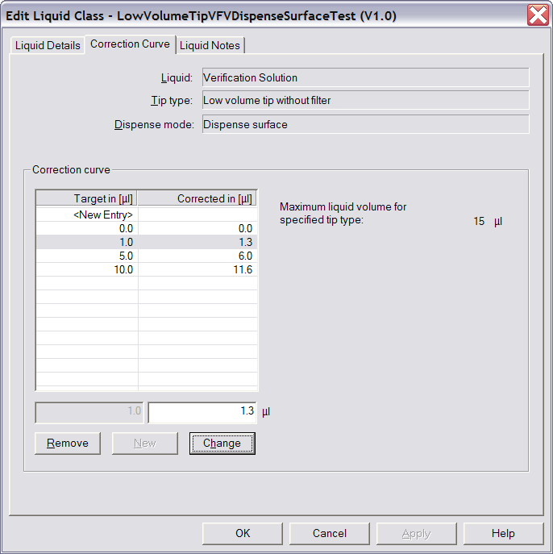
Adjusting the Correction Curve
Determine correction curve empirically, after CVs are optimized
Set data points for known target volumes
For aliquotting, set values for each volume in the tip

Slide 26
Correction Values
After the parameters have been optimized (droplets, CV), correction values are determined
Correction values have to be determined gravimetrically based on the liquid density
The default correction values are determined for the use of new tips (one aspiration)
Generally, correction values can be determined and specified for every pipetted volume
Between defined volumes, linear interpolation is applied
Correction curves are most often non-linear

Slide 27
Properties of Correction Curves
All correction curves must
  start with (0/0)
  increase monotonically (no up&down)
  have at least 2 values (0/0) and (max/max)
  be unambiguous: one corrected volume for one target volume

Slide 28
Correction Curves: Example 1
Corrected Volume
Single Asp/Disp #1
Target volume 50 µl
Plunger moves 55 µl
Single Asp/Disp #2
Target volume 200µl
Plunger moves 211 µl
Use Target Volume in Asp/Disp Dialogs!
350
211
55
0
Target Volume
0
50
200
350

Slide 29
Correction Curves: Example 2
Corrected Volume
Asp Vol: 200 ul
Plunger moves 215 ul
Pre-Dispense: 40 µl
Plunger moves 40 ul
1.Part volume: 80 µl
Plunger moves 90 µl
2.Part volume: 50 µl
Plunger moves 55 µl
Post-Dispense: 30 ul
Plunger moves 30 µl
215
Pre
175
Δ 90
1.Part
85
2.Part
Δ 80
30
Post
0
0
30
80
160
200
Target Volume

Slide 30
Hints for Pipetting Water
Pure water does not act the same as verification solution or aqueous buffers due to its high surface tension.
    It is very difficult to pipette at small volumes.
    Avoid using it to test in lieu of actual liquid.
    Add some salt or other surfactant to have it act more realistically and for easier handling.
    If you have to pipette small volumes of deionized water, be prepared for much trial-and-error.

Slide 31
Hints for Pipetting Volatiles
Pre-wet/pre-mix 3 or more times with the total aspiration volume
Minimize time between aspiration and dispense
Speed up the aspiration and dispense
Set large aspiration blowout volume to create space for vapor
Large or accumulated transport air gaps can let fluid “leak” down and out of tip
Use ADC (starting June, 2006)

Slide 32
Hints for Pipetting Viscous Fluids
Aspirate and dispense slowly
Try pre-wetting (slowly) once with the total aspiration volume
Use large enough blowout, but avoid bubbles
Use air transport if drops form

Slide 33
Hints for Multi-Dispensing
For Aliquoting N dispenses of Volume V:
Aspirate (N+2) x V
Dispense V as a Pre-aliquot
Dispense N x V as main aliquots
Dispense 1 x V as Post-aliquot (or waste it with the tip)
Sometimes two pre-aliquots are needed.

Slide 34
Typical Aliquoting Curve
Volume Dispensed
CV=2-3%
Number of aliquot

Slide 35
Hints Regarding Precision
Pipetting precision in descending order:
  Use new tips for every step
  Multiple aspiration/dispense cycles with the same tip (pre-wetting before first aspiration helps)
  Aliquoting
CVs for V_{pip}<20μl are better with surface dispense (dispense larger quantity of buffer into container first, followed by the small sample)
Pooling: Long waiting times for last channel (>2min) may cause droplet formation
  Use parallel dispenses for multiple pools

Slide 36
Priority List for Improvements
Making improvements or troubleshooting? Look into…
Environmental Conditions: Check if they are kept constant and are similar to others
Labware: Check if they are correct per deck layout
Method: Optimize it to achieve short waiting time and optimum parallelism
Aspiration/Dispense Steps: Check modes, LLD, etc.

Slide 37
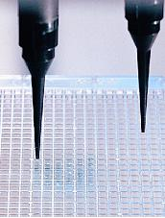
Keep in Mind
These are general guidelines
They are intended to get you started
This is a trial and error process
Every single project is different and needs to be treated individually
Be patient!
Keep learning!

